Slide 1

v.0.0.3

Slide 2


Welcome to
MLH Localhost: Hacking with Alexa!
Wifi Network:
[eduroam]
[UB_Secure]
Event Hashtag:
#MLHLocalhost
Twitter Handle:
@MLHacks

Slide 3
Event Sign In Form
https://tinyurl.com/yd5nqhmt

Slide 4
Using your Web Browser,
Open this URL & Fill out the Form:
Afterwards, Check your Email to Find:
1
http://mlhlocal.host/checkin
2
Setup Instructions
An Invite to the MLH Slack
The Code Samples
A Workshop FAQ
These Workshop Slides
More Learning Resources

Slide 5
Welcome! My name is
Aniruddha Nandi.
1
I’m will be leading this session to help you learn something new today
2
I’m a Junior in CS & Lead of Project AI in the Robotics Club
3
Things I love to do include globetrotting, aerial photography and hacking

Slide 6

Our Mission is to Empower Hackers.
65,000+
HACKERS
12,000+
PROJECTS CREATED
3,000+
SCHOOLS
We hope you learn something awesome today!
Find more resources: http://mlh.io/

Slide 7
What will you learn today?
1
Understand Voice User Interfaces & what you can build using them.
2
Meet Alexa, an intelligent personal assistant developed by Amazon.
3
Create your first voice powered app with Amazon Alexa.

Slide 9
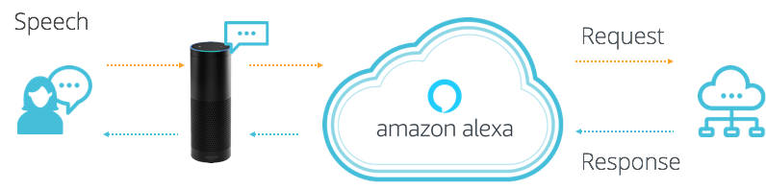
What is Alexa?
Alexa is a Voice User Interface (VUI), that lets you speak commands, instead of clicking buttons or typing on your keyboard.
Alexa listens to spoken input, uses it to execute tasks or skills in the cloud, and then returns output -- just like a JavaScript function.

Slide 10


Why do Voice UIs Matter?
Instead of typing, clicking, or tapping - we can physically separate ourselves from our devices and speak commands naturally.
Voice UIs can run code in the cloud and communicate with IoT devices, making them ideal for homes, cars, & more.
Notes:
VUIs signify a big shift in how we interact with technology
We can physically separate ourselves from devices and speak naturally
Where might voice user interfaces be useful?
While driving the car
When running or exercising
While cooking a meal
For easier & intuitive interaction

Slide 11

What can you build with Alexa?
Alexa, ask Lyft for a Lyft Line to work.
Notes:
Alexa is programmable, so you can connect it to webapps and other APIs
You could build smart remotes for your TV, a skill to hail a cab, order a pizza, etc.
The next few slides contain some examples.
Lyft - you can ask Alexa to call a lyft cab to your location.

Slide 12


What can you build with Alexa?
Alexa, ask Capital One, what did I spend?
Notes:
Capital One - Check on your bank account and spending habits.

Slide 13
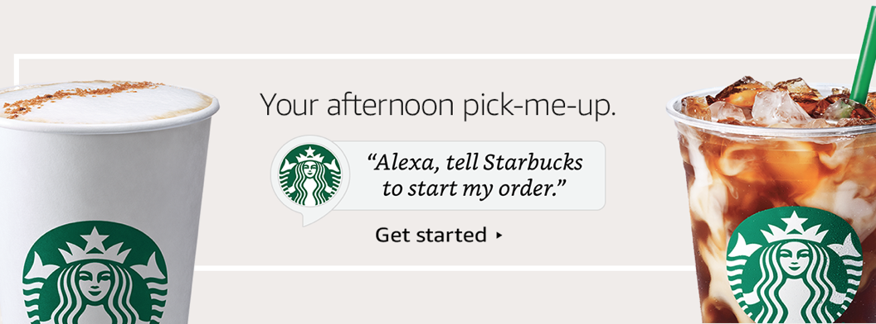
What can you build with Alexa?
Alexa, tell Starbucks start my order.
Notes:
Starbucks - order your coffee ahead of time when you’re walking out the door.

Slide 14
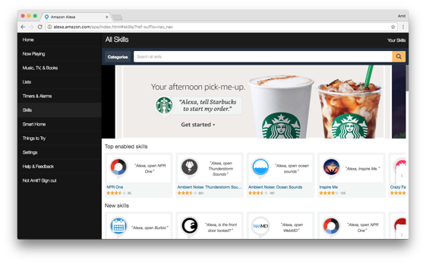
Alexa has Skills. Lots of them.
Companion app for device setup, skills, remote control, and more.
alexa.amazon.com
Notes:
Alexa has tons of skills you can use today
Here are some other popular ones if you need examples:
NPR - Listen to Podcasts
Seamless - Order delivery to your house
Jeopardy - Play Jeopardy with Alexa.

Slide 15
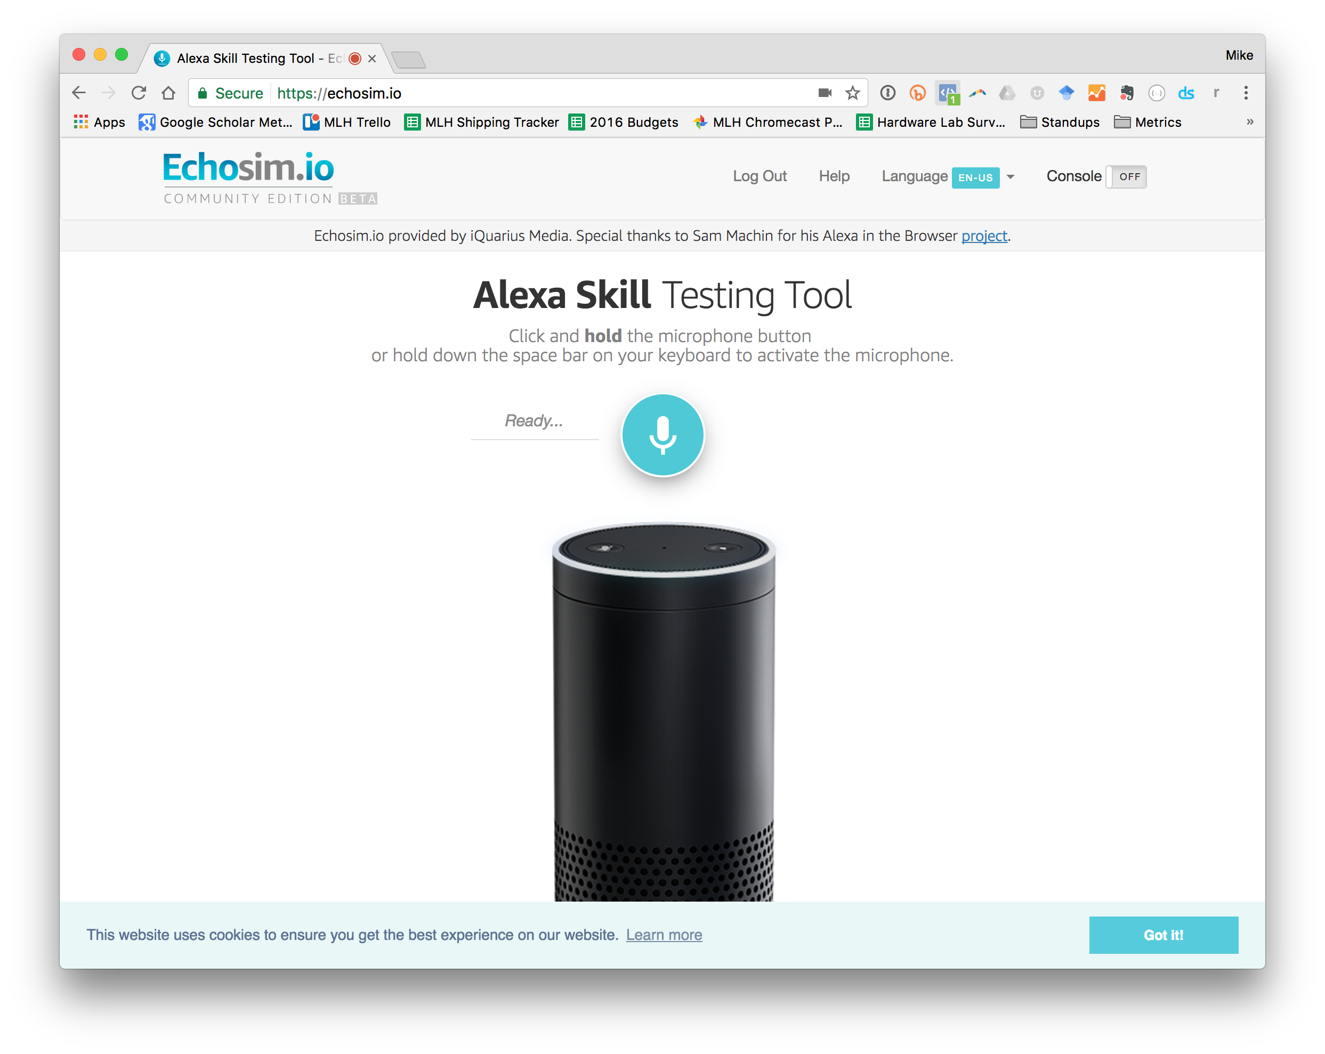


It’s LIVE Demo Time!
Try these commands:
“Alexa, tell me a joke!”
“Alexa, what is
Major League Hacking?”
Don’t have an Alexa device?
Head to: echosim.io

Slide 17

Why build an Alexa Skill?
Alexa, Amazon's voice service, is already integrated into Echo devices and can perform hundreds of skills.
Your skill can reach millions of customers with Alexa enabled devices.
Building with Alexa is free, easy, & fun!

Slide 18


Alexa Skills are made of 2 parts:
Front End - The Alexa Voice UI handles text to speech, converting the audio into something our app can use, etc.
Back End - The logic code that actually powers our app. Usually this is written on a service called AWS Lambda.
AWS Lambda
Notes:
Each Alexa skill is made of two parts
Front End is the Alexa Voice User Interface. This takes user speech and converts it into something the computer can understand
Back End is where your application logic lives. This takes the parsed speech and does something interesting with it.
FAQ:
What is AWS Lambda?
You can think of Lambda as an event-driven computing platform; Lambda runs when triggered by an event and executes code that’s been loaded into the system. You don’t need to setup or manage any servers, just write the code and Amazon takes care of the rest.

Slide 19

Speech Recognition is Hard.
You said: fȯr tē tīmz. But, what did you mean?
Forty Times?
For Tea Times?
For Tee Times?
Four Tee Times?
Notes:
Understanding human speech is a hard problem for computers
There are two parts to understanding speech:
Speech Recognition - converting the audio to text
Natural Language Understanding - what is the context of this text?
Amazon has collected the top speech technology for you with Alexa, you don’t need to be an expert

Slide 20
Parts of Speech Recognition
Automatic Speech Recognition (ASR)
Enables the recognition and translation of spoken language into text by computers.
1. Traditional phonetics-based using HMM’s (Hidden Markov Models)
2. Deep feedforward neural network or RNN (recurrent neural nets) based

Slide 21
Parts of Speech Recognition
Natural Language Understanding (NLU)
Deals with how to best handle unstructured inputs that are governed by poorly defined, flexible rules and convert them into a structured form that a machine can understand. It is an AI-hard problem.
“I need a flight and hotel in Miami from October 4 to 10”
need:flight {intent} / need:hotel {intent} / Miami {city} / Oct 4 {date} / Oct 10 {date} / sentiment: 0.5723 (neutral)

Slide 22
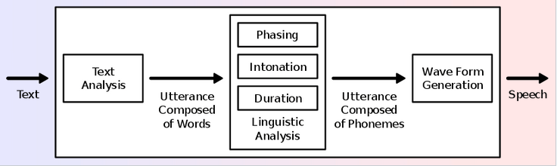
Parts of Speech Recognition
Text to Speech (TTS)
Converts text back to human-understandable speech

Slide 23
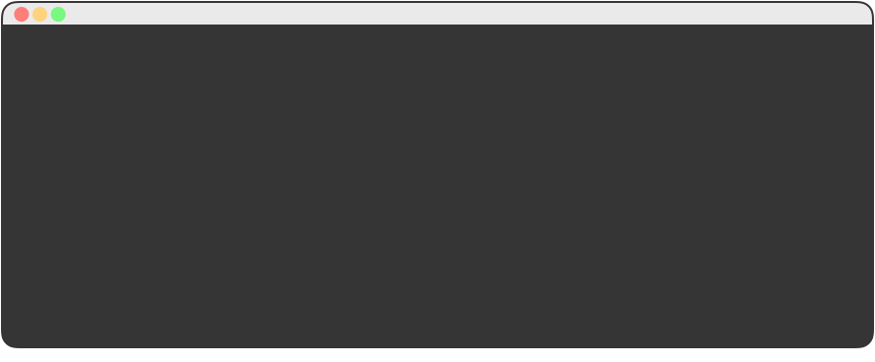
Alexa uses Sample Utterances
for Training.
In order to map user input to a behavior, we provide training data, for each intent.
01 GetNewFactIntent a fact
02 GetNewFactIntent a Major League Hacking fact
03 GetNewFactIntent tell me a fact
04 GetNewFactIntent tell me a Major League Hacking fact
05 GetNewFactIntent give me a fact
06 GetNewFactIntent give me a Major League Hacking fact
07 GetNewFactIntent tell me trivia
08 GetNewFactIntent tell me a Major League Hacking trivia
09 GetNewFactIntent give me trivia
10 GetNewFactIntent give me a Major League Hacking trivia
11 GetNewFactIntent give me some information
12 GetNewFactIntent give me some Major League Hacking information
13 GetNewFactIntent tell me something
14 GetNewFactIntent give me something
Notes:
In order to map user input to something, we provide Alexa training data
This slide shows some example training data which takes the format:
[Skill] [Sample Speech to Trigger This Skill]
The sample skill is called “GetNewFactIntent” and “give me a fact” is an example thing someone might say to trigger it
Your list doesn’t need to be exhaustive (every possible combination), Alexa will use this data to train herself and learn new phrases

Slide 24
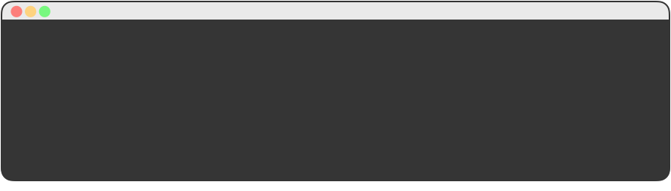
Alexa Maps Speech Input to Intents.
Once Alexa figures out what Intent you wanted, you can easily map that back to code.
01 {
02 "intents": [
03 { "intent": "GetNewFactIntent" },
04 { "intent": "AMAZON.HelpIntent" },
05 { "intent": "AMAZON.StopIntent" },
06 { "intent": "AMAZON.CancelIntent" }
07 ]
08 }
“Tell me a Fact about MLH” GetNewFactIntent
Notes:
An Alexa Skill (App) can have multiple commands.
We call those commands “Intents”
For example, an app that plays music may have a “Play” intent to start the music and a “Pause” intent to temporarily stop the music.
We tell Alexa what our intents are in a configuration file like this one.

Slide 26
Demo: About MLH Skill
Ask your Alexa:
“Alexa, open MLH Facts.”
“Alexa, ask MLH Facts for a fact.”
Don’t have an Alexa device?
Head to: echosim.io
Notes:
Setup:
Make sure you have the MLH Facts skill enabled. You can do this from the Alexa App on your phone.

Slide 27
Steps to Build Your Skill:
To build your first skill, we’ll complete the following steps:
Write your skill code as an AWS Lambda function
Create an Alexa Skill in the Developer Portal
Connect Your Lambda Function to Your Skill
Test your Skill
Publish Your Skill

Slide 28
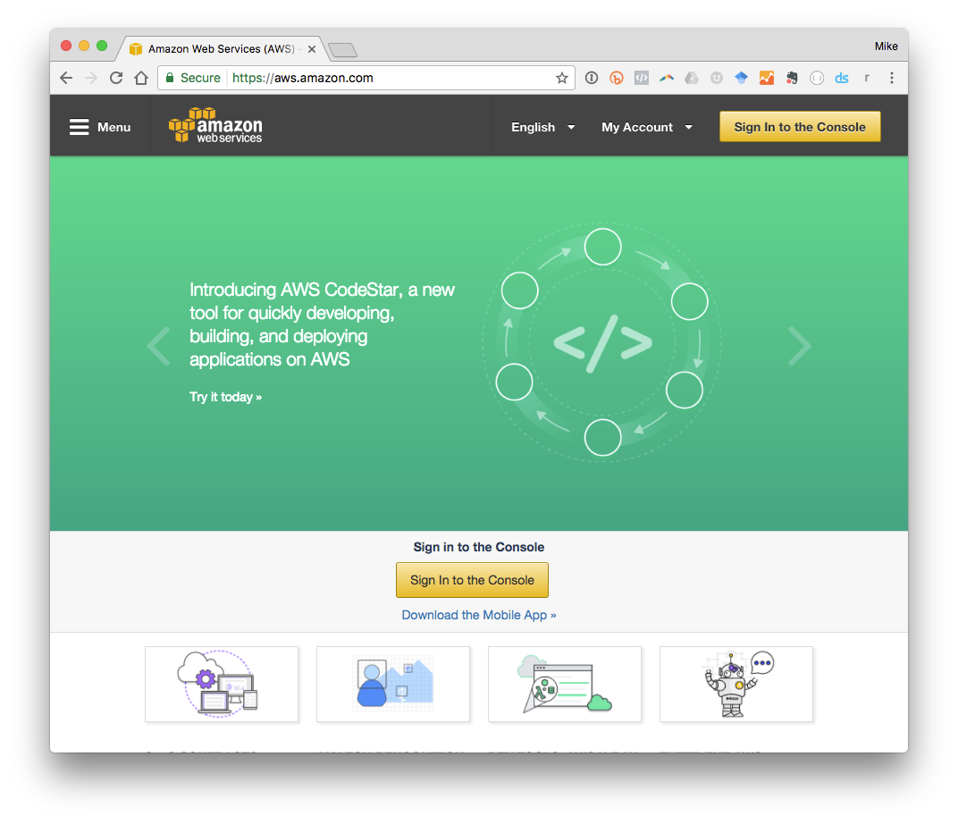
Sign into the AWS Console.
Navigate to:
mlhlocal.host/alexa-aws
Instructions
Click on “Sign in to Console” to get started.

Slide 29
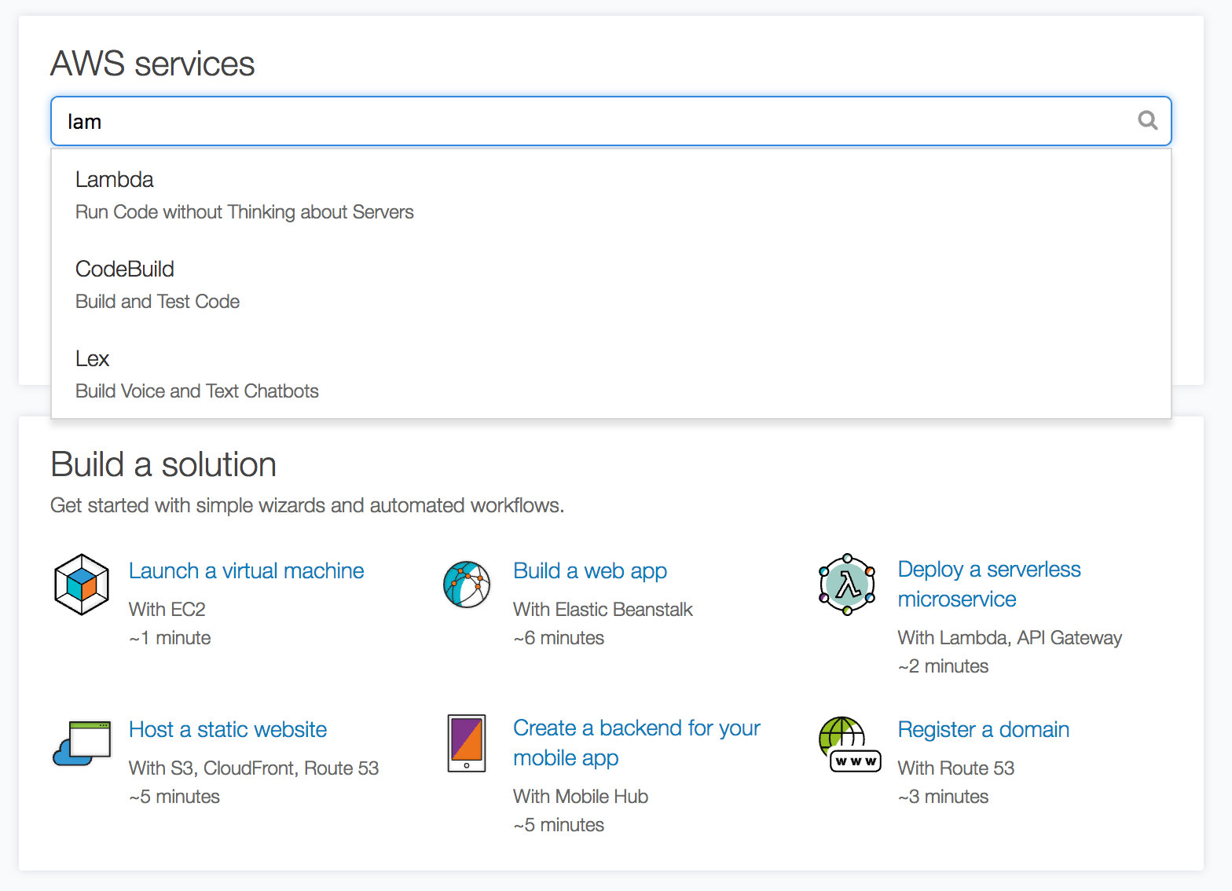
Navigate to the Lambda Manager.
You can search for Lambda in the search box or find it on the list of available services.
Notes:
Confirm that you are using the “Northern Virginia” region.
In the top right corner, next to their name.
It should say “N. Virginia”
If it doesn’t, they can select “US East (N. Virginia)” from the region dropdown

Slide 30
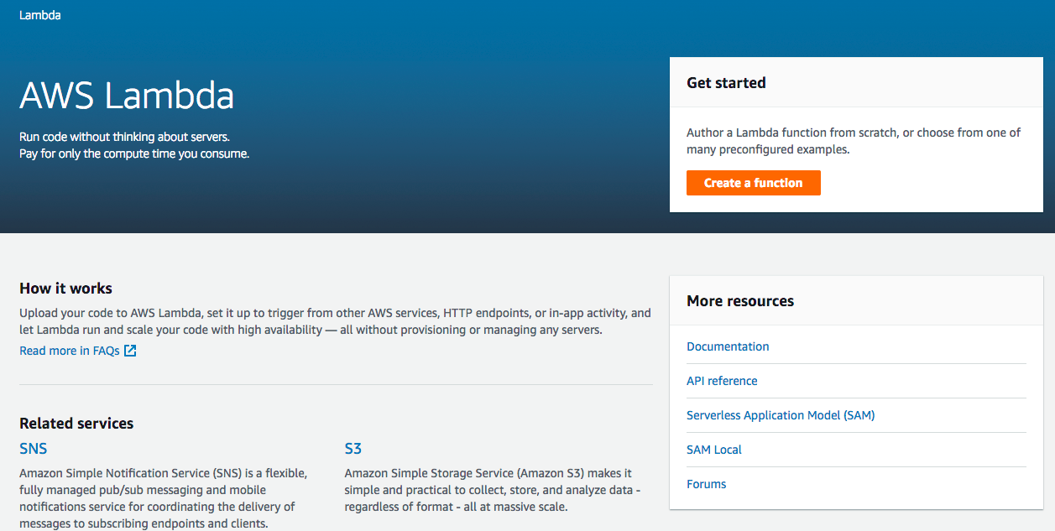
Create your First Lambda Function.
Each AWS Lambda Function is responsible for one thing (like returning facts about you!).
Click “Create a Function” to create your first function!
Instructions

Slide 31
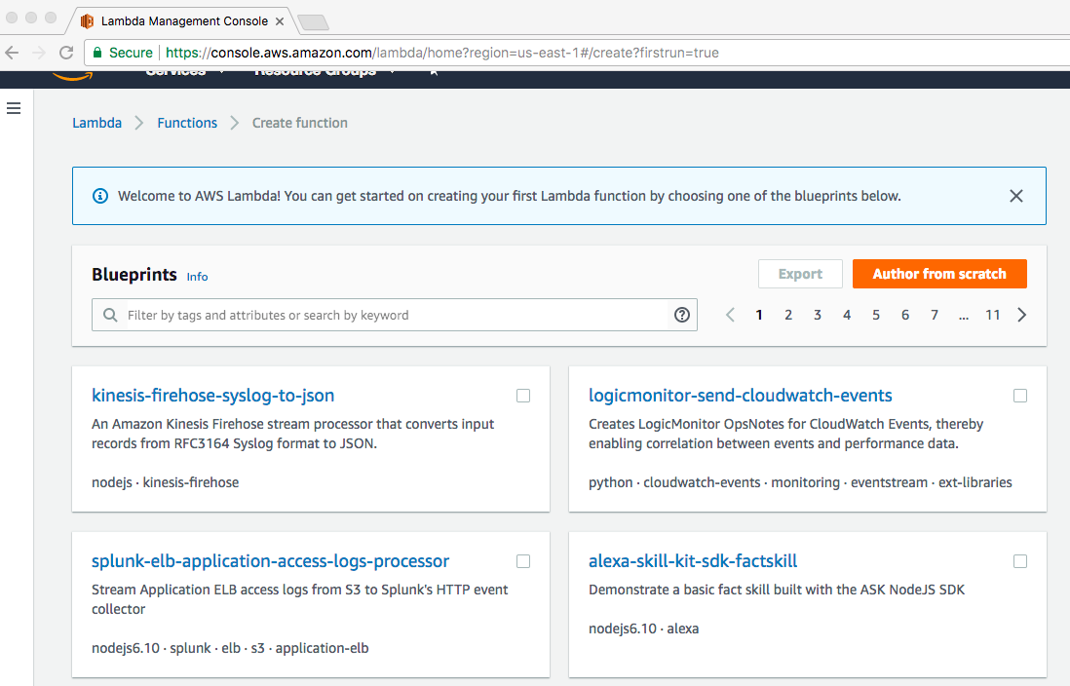
Choose a Blueprint.
Instructions
Select “alexa-skill-kit-sdk-factskill” from the options.

Slide 32
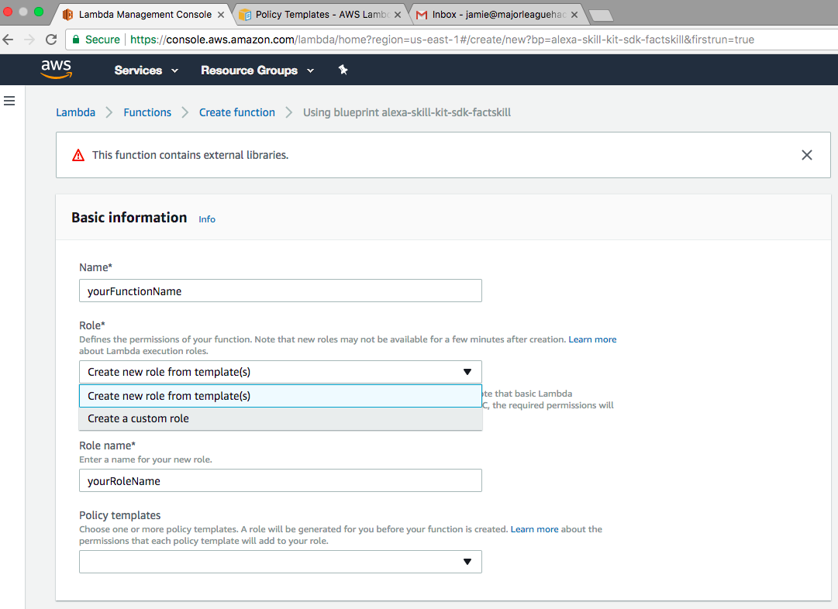
Set Basic Information.
Instructions
Enter a name, select “Create a custom role,” and name your role.

Slide 33
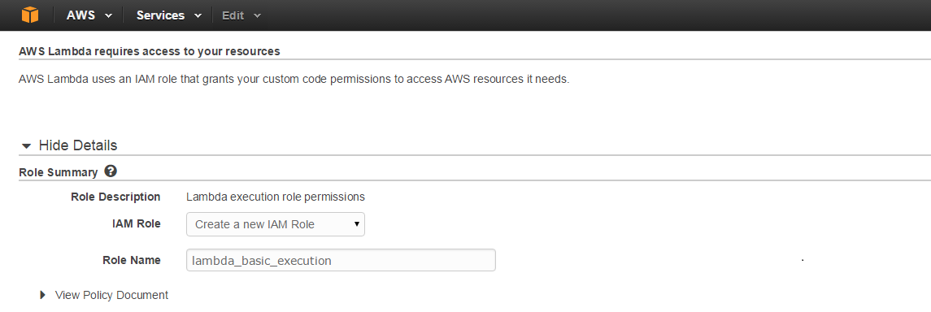
Create your IAM Role.
Instructions
Select "Create a new IAM Role" from dropdown menu. Role Name & policy will automatically populate.
Select “Allow” in the lower right corner and you will be returned to your Lambda function.

Slide 34
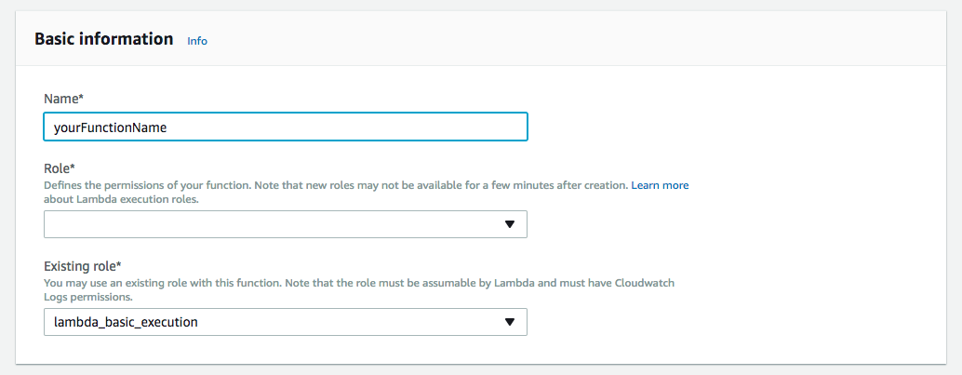
Create your IAM Role.
Notice that “lambda_basic_execution” is now in the “Existing Role*” field.
Notes:
You should be redirected back to the previous page and “lambda_basic_execution” will be in the Existing Role* field.

Slide 35
Step 1: Download the Sample Code
Step 2: Open Index.js
To get the sample code, head to this URL:
mlhlocal.host/alexa-code
Unzip the directory and open src/index.js in your
favorite code editor.
Notes:
To create your skill, you’re going to be editing a sample MLH is providing you
The link is in your email as well since you checked in
Download the Zip file by following the link on the screen or their email
Unzip the file and open the directory called “src” inside it
Open index.js in their favorite code editor (they can download Atom or Sublime if they don’t have one)
Walk around and make sure everyone is able to open the file.

Slide 36
Customize your Facts
Instructions
Find the FACTS array inside index.js.
Replace the facts about MLH with facts of your choice!
12 // TODO: replace with facts about yourself
13 const FACTS = [
14 "Major League Hacking is commonly called MLH.",
15 "Major League Hacking's mission is to empower hackers.",
16 "Over 65,000 student hackers participated in Major League Hacking...",
17 "Major League Hacking was founded in 2013 by Swift and Jon.",
18 "Hackers created over 12,000 projects at MLH hackathons in 2016.",
19 "Over 200 schools around the world hosted MLH hackathons in 2016.",
20 "Major League Hacking is headquartered in New York City."
21 ];
Notes:
The first section of this file contains a list of facts about MLH.
We store this in a variable called “FACTS”
We’re going to replace these with some facts of your choice
Each line needs to end with a comma (“,”) except the last one

Slide 37
Code Review: The Handlers Object
The handlers object tells Alexa how to handle various actions. GetFact is the main logic of our application.
23 var handlers = {
24 'LaunchRequest': function() { this.emit('GetFact'); },
25 'GetNewFactIntent': function() { this.emit('GetFact'); },
26 'GetFact': function() {
27 // Randomly select a fact from the array
28 const factIndex = Math.floor(Math.random() * FACTS.length);
29 const randomFact = FACTS[factIndex];
30
31 // Create speech output
32 const speechOutput = "Here's your fact: " + randomFact;
33 this.emit(':tellWithCard', speechOutput, "MLH Facts", randomFact);
34 }
35 };
Notes:
The next section maps intents (Launch and Get New Fact) to actual code.
Both “LaunchIntent” and “GetNewFactIntent” trigger the “GetFact” function.
The GetFact function does the following:
Select a random element from the FACTS list
Prepend “Here’s your fact” to the fact
Tell Alexa to respond with the fact by emitting a “:tellWithCard” event.

Slide 38
Code Review: The Handler Function
The handler function tells Alexa how to route voice commands by passing a copy of the handlers object.
37 // AWS Lambda calls this function every time Alexa uses our skill.
38 exports.handler = function(event, context, callback) {
39 // Include the AWS Alexa Library.
40 const Alexa = require("alexa-sdk");
41
42 // Create an instance of the Alexa library & pass it the requested command.
43 var alexa = Alexa.handler(event, context);
44
45 // Give our Alexa instance handling instructions & execute the request.
46 alexa.registerHandlers(handlers);
47 alexa.execute();
48 };
Notes:
The final section passes our configuration to Alexa using the Alexa SDK
We instantiate a new Alexa object and pass it the parsed speech the user gave us
Register the list of handlers we created in the last section so Alexa knows how to respond.
Execute the request.

Slide 39
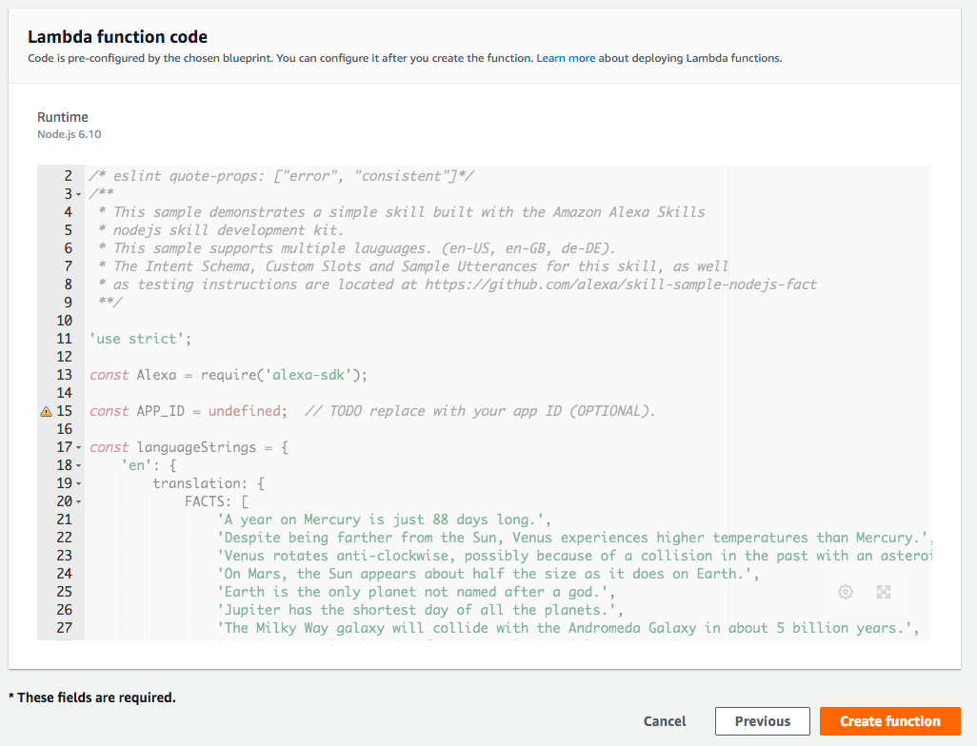
Create your Function.
Instructions
Click “Create Function” at the bottom of the page

Slide 40
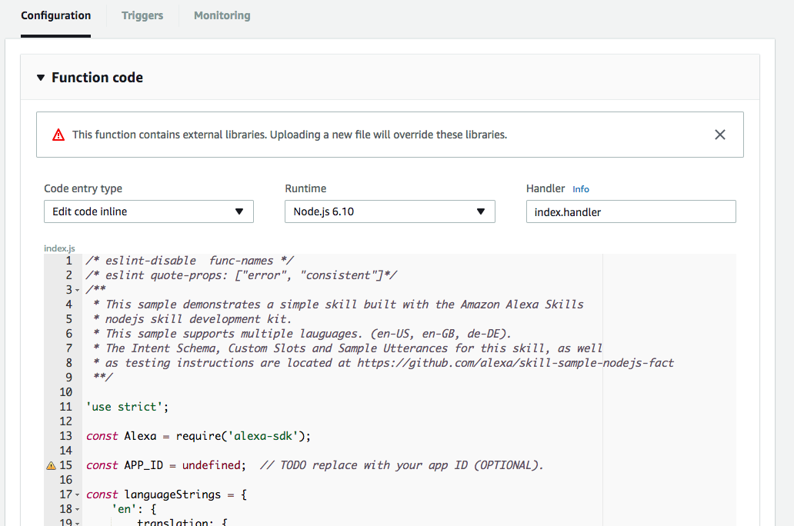
Copy & Paste your Code into the Lambda Editor
Instructions
Copy the entire contents of index.js and paste it over the code in the inline editor on the AWS Console.
Notes:
You should leave the default settings - Edit code inline, Node.js 6.10, index.handler
Copy the full contents of the index.js file into the Lambda editor on the AWS website (completely overwrite any existing code on the Lambda editor)
Make sure you copy the full file and paste over the entire contents of what is already in the editor.
Make sure to click “Save” - NOT “Save and Test” at the top of the screen.

Slide 41
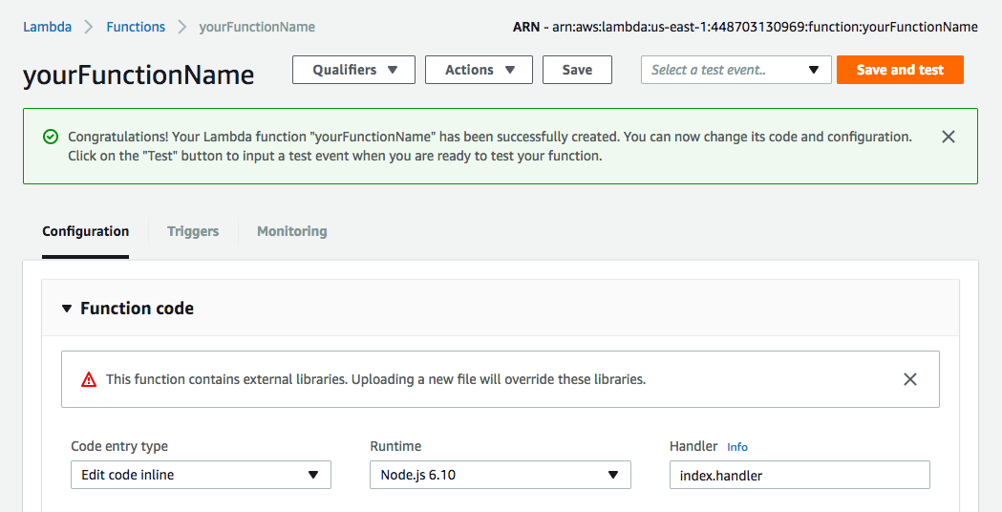
Save your Code.
Instructions
Click the white “Save” button (not the orange one).

Slide 42
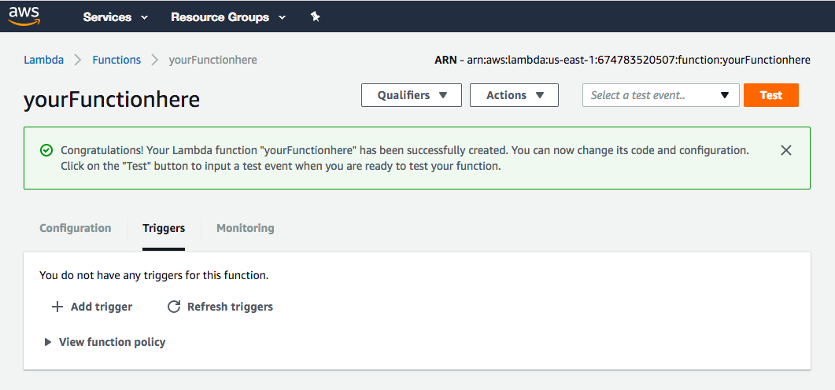
Configure your Trigger.
We need to setup a trigger to call our new Lambda Function (in our case Alexa Skills Kit).
Instructions
Click “Triggers”
Click “+ Add Trigger”
Notes:
AWS Lambda Functions are triggered by events
In this case, we want our function to be triggered by the “Alexa Skills Kit” event
Tell hackers to make sure their AWS Region is set to US East 1 (so they may have to click “Ohio” and make it say “N. Virginia”) or “Alexa Skills Kit” will not appear

Slide 43
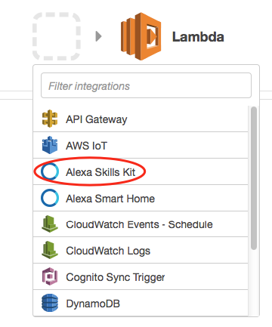
Configure your Trigger.
Instructions
Click on the gray dash-lined box
Select “Alexa Skills Kit” from the dropdown menu

Slide 44
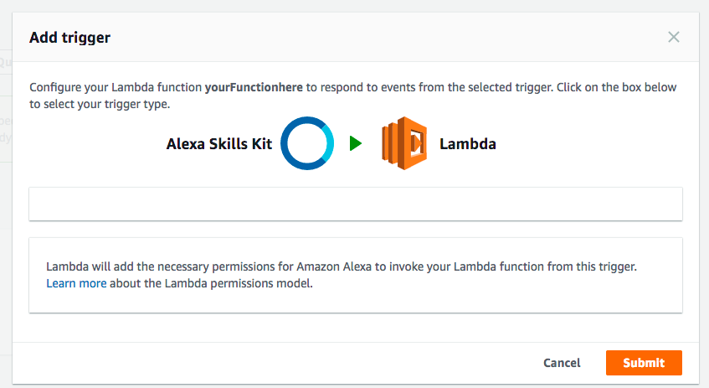
Configure your Trigger.
Instructions
Click “Submit.”

Slide 45
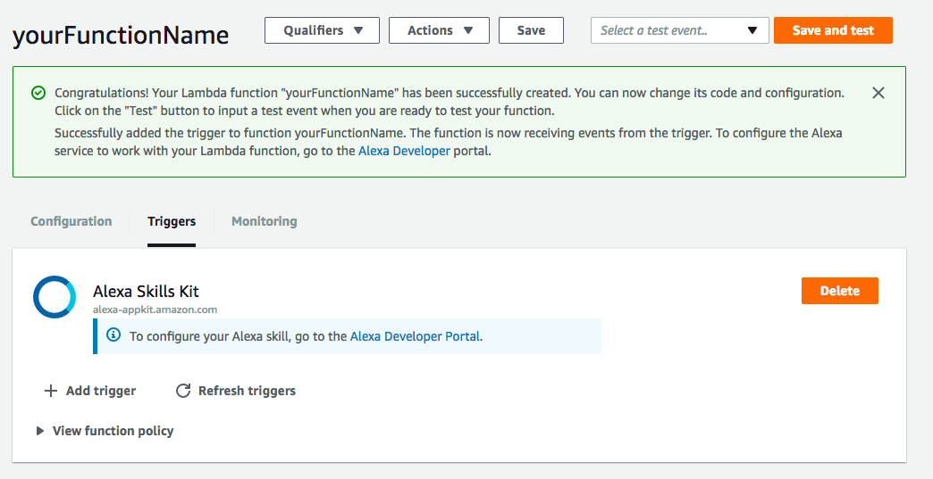
Test your Trigger.
Instructions
Click “Save and Test.”

Slide 46
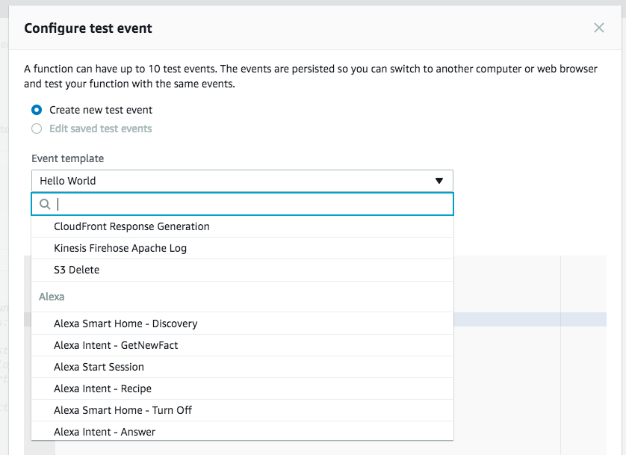
Test your Trigger.
Instructions
Click “Hello World.”
Scroll down and select “Alexa Intent - GetNewFact.”

Slide 47
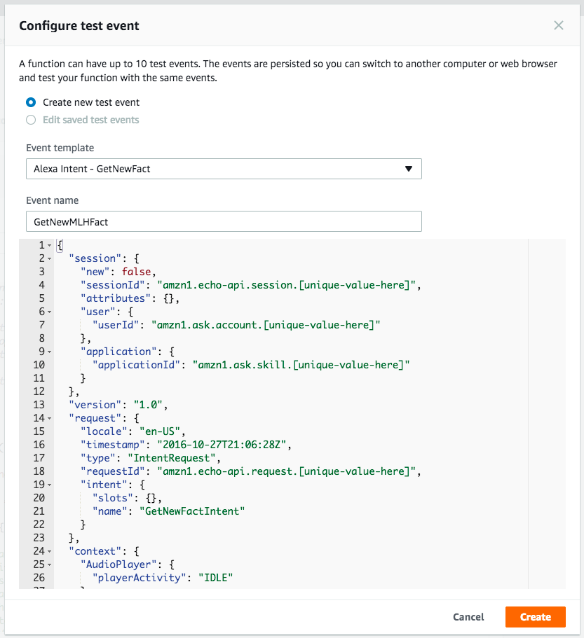
Test your Trigger.
We need to setup a trigger to call our new Lambda
Instructions
Name your test event.
Click “Create.”

Slide 48
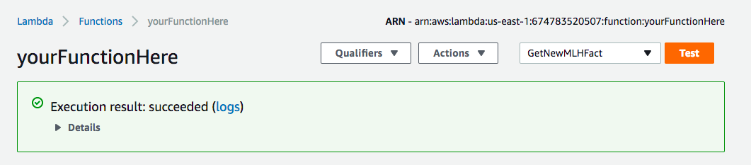
Test your Trigger.
Instructions
Click “Test.”

Slide 49
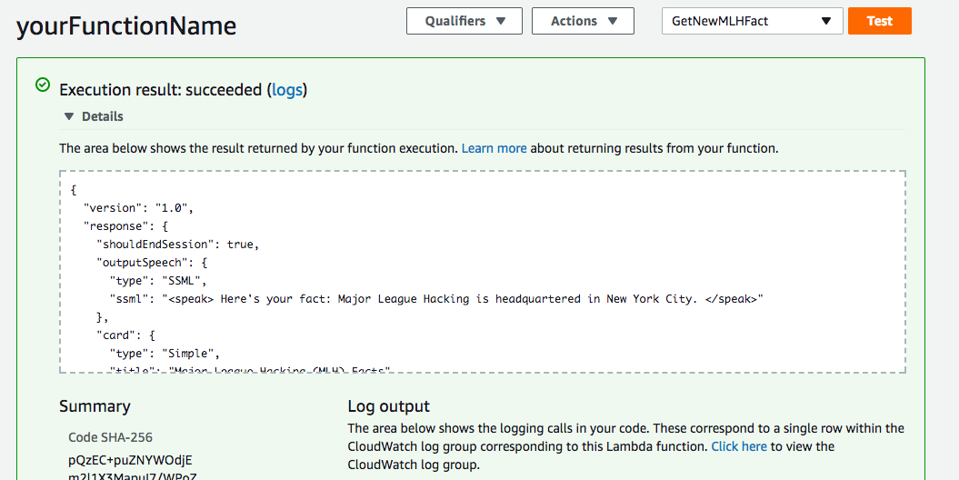
Test your AWS Lambda Function
If it’s working, you can click “Details” to see output
similar to the following:

Slide 50
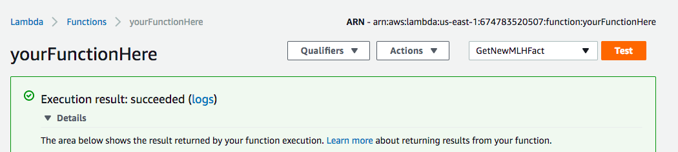
Note Down your Function’s ARN.
You’ll need it in a few steps, so either keep this tab open or save it in a file somewhere now.
Notes:
We’ve completed the backend of your Alexa skill using AWS Lambda.
Next we’re going register our function as an actual skill that Alexa can use
Before we move on, note the “ARN” (Amazon Resource Name) at the top of your screen. This is basically a unique identifier for your Lambda function.
We’re going to need this to connect our Alexa skill in a few minutes, so keep this tab open or copy it into a file on your desktop.

Slide 51
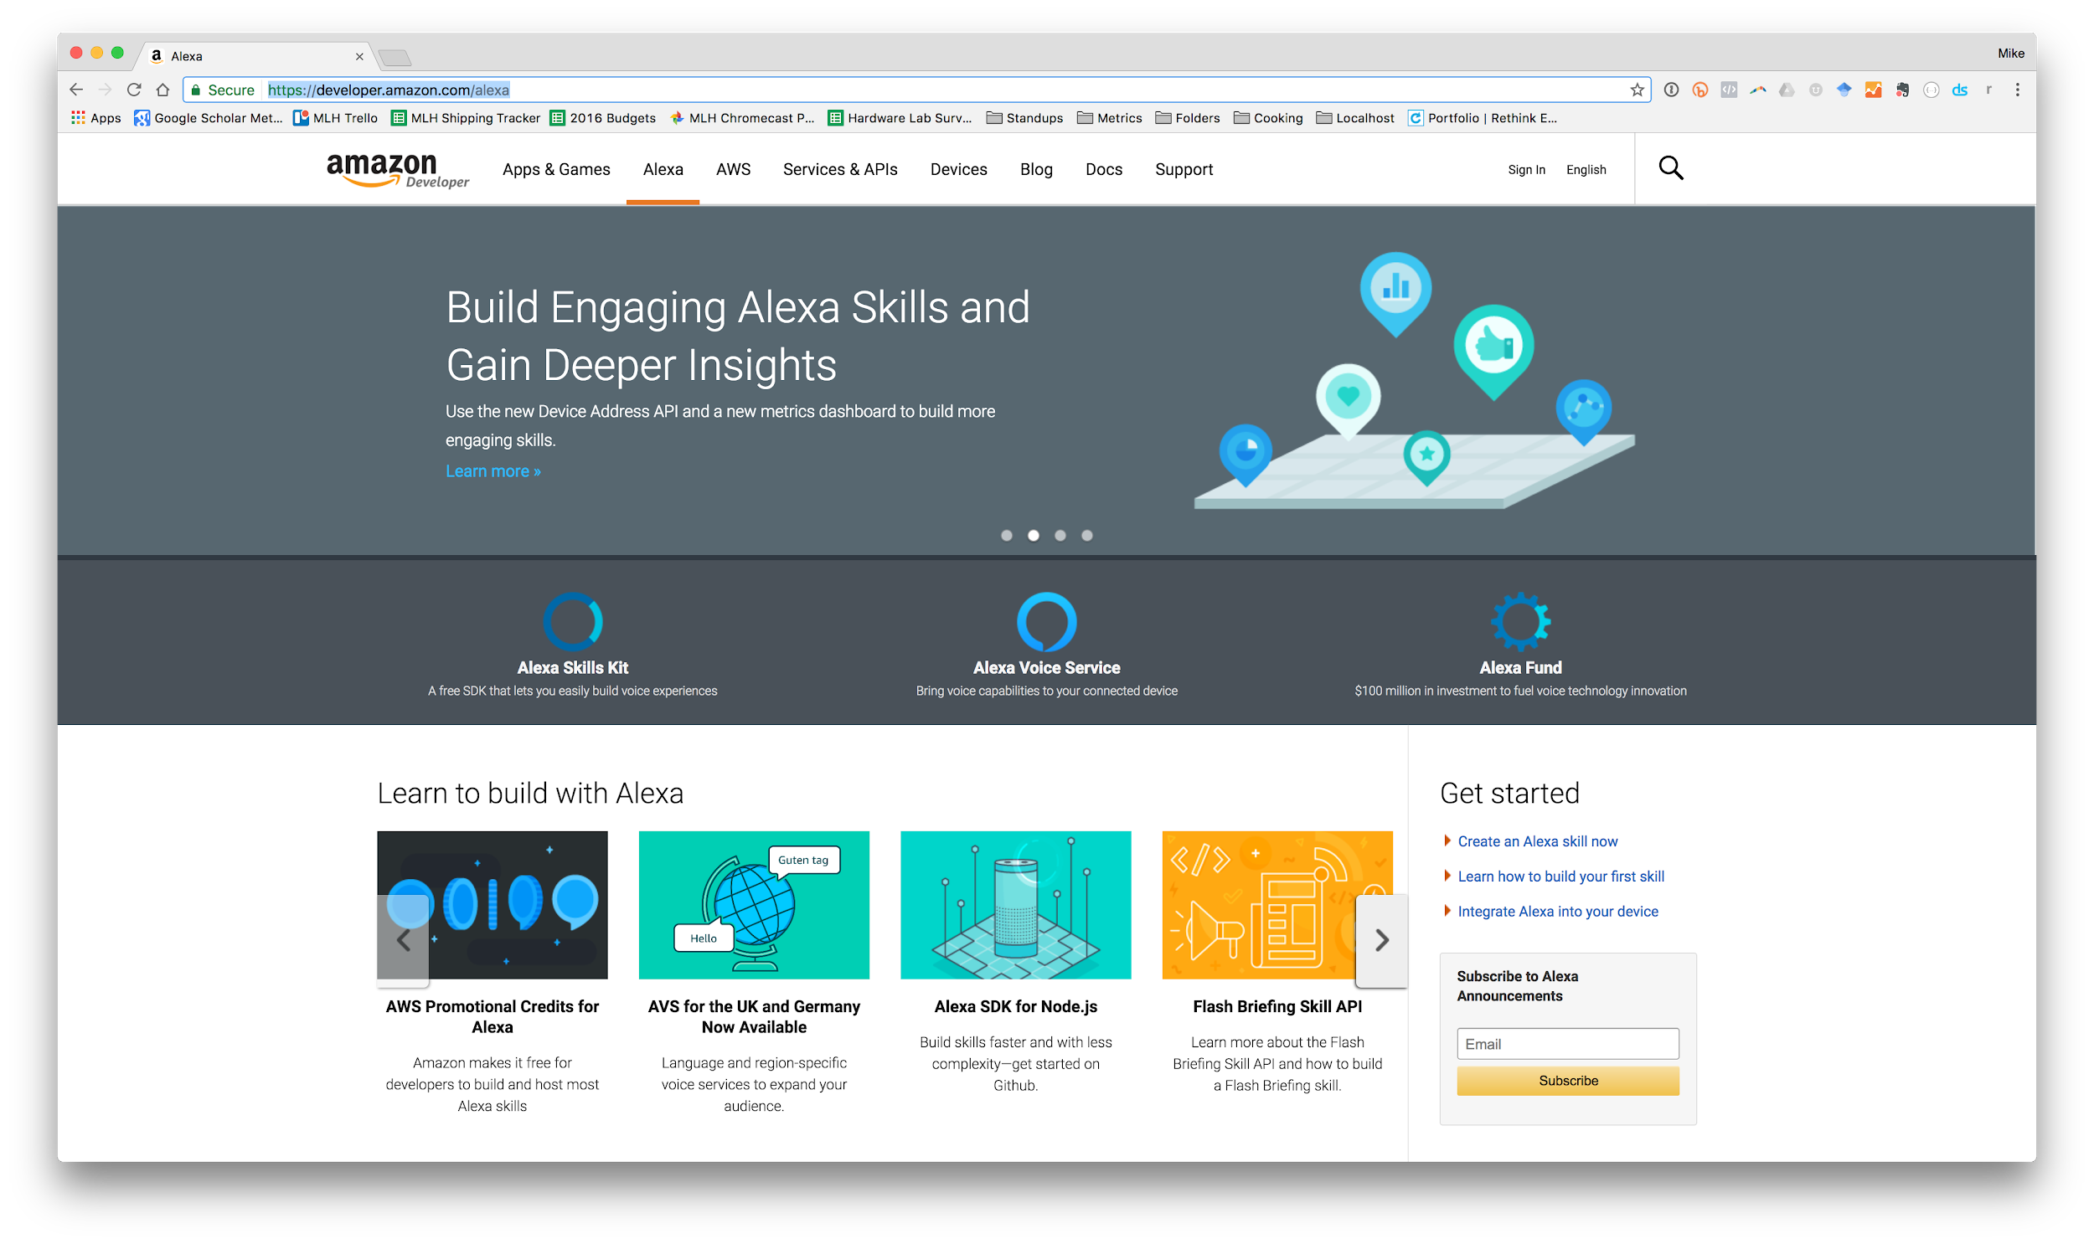
Sign into the Amazon Developer Portal.
Head over to:
mlhlocal.host/alexa-portal

Slide 52
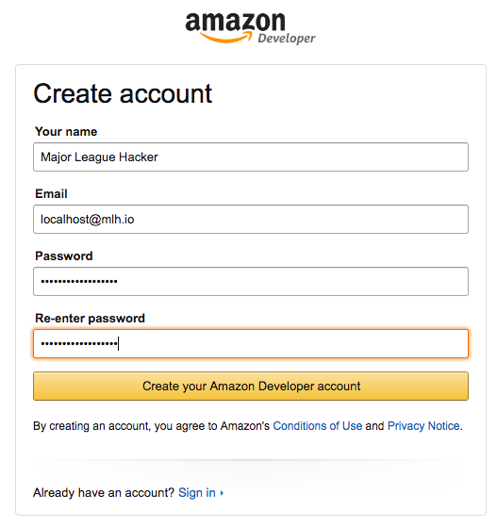
Create your account.
Instructions
Fill in this form.

Slide 53
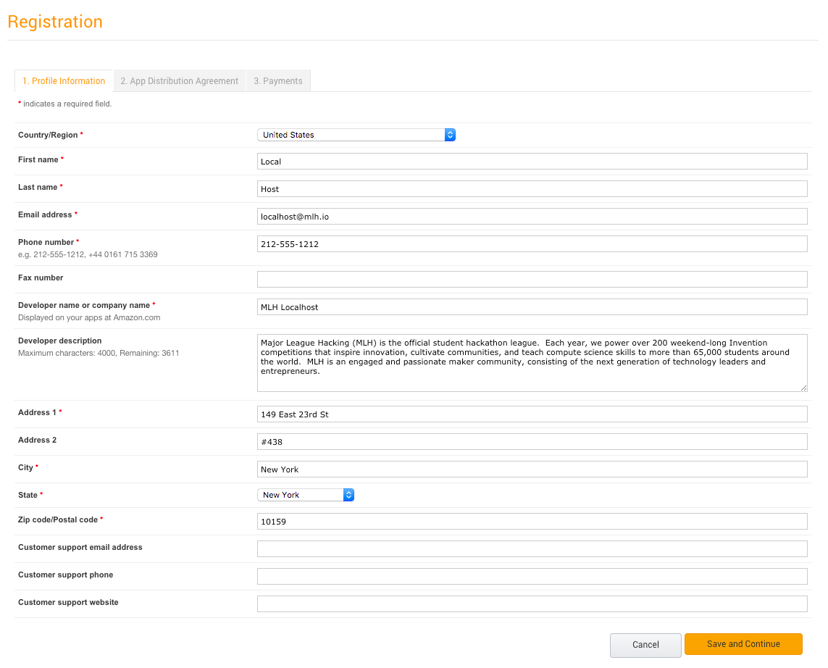
Create your Developer Profile.
Instructions
Fill out the registration form & agree to the terms of use.

Slide 54
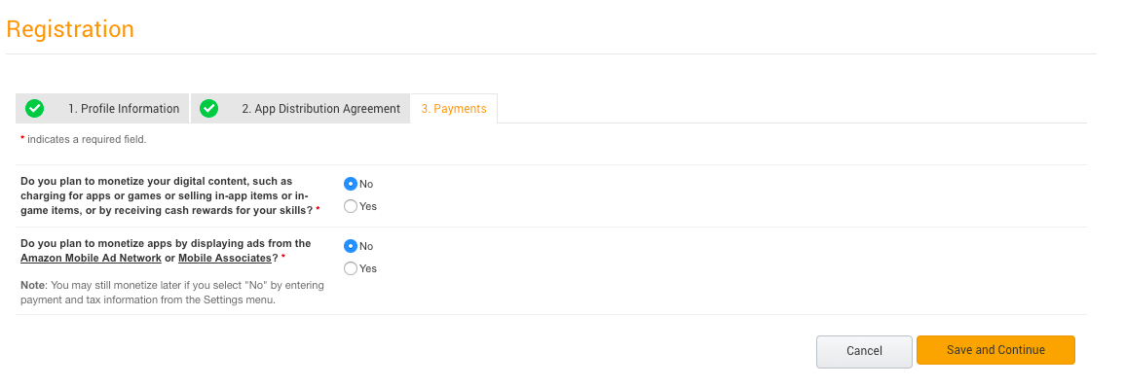
Create your Developer Profile.
Instructions
Fill out the registration form & agree to the terms of use.

Slide 55
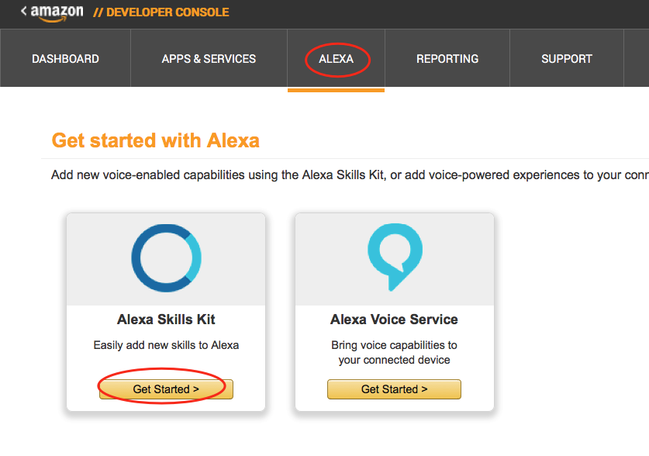
Create a New Alexa Skill.
Instructions
Navigate to the Alexa tab.
#1
#2

Slide 56
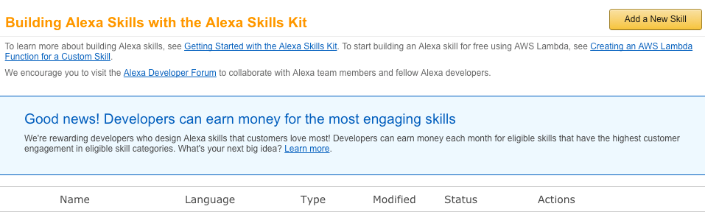
Create a New Alexa Skill
Instructions
Click on "Getting Started" under “Alexa Skills Kit.”
Click “Add a New Skill” in the top right.

Slide 57
What is the Invocation Name?
Alexa, open MLH facts.
This is a 1-3 word phrase that users will say out loud to launch your skill.
Wake Word
Launch
Skill Invocation Name
Notes:
On this screen, you’re being asked to enter an “Invocation Name.” What is an Invocation name?
Users will say something with the following structure to Alexa:
Wake Word - this is the word which signals that Alexa should start listening.
Launch - this is the instruction for Alexa about what to do. Since this is a skill launch means open the corresponding application.
Skill Invocation name - the phrase that a user will utter to launch your skill.

Slide 58
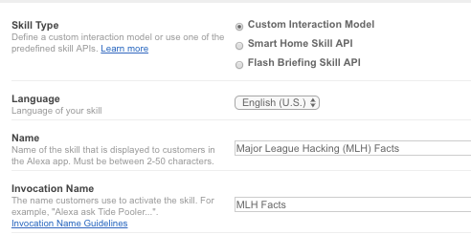
Name your Skill
Instructions
Select “Custom Interaction Model” for Skill Type
Enter a Name for your Skill.
Enter an Invocation Name for your Skill.
Select the "No" option under Audio Player and click “Next”.
Notes:
Make sure you have “Customer Interaction Model” selected for skill type. There are a bunch of other types of Alexa skills, but this is the most common one.
Give your skill a name that other people would see on the Alexa App.

Slide 59
Grab the Intent Schema JSON
There’s a file called SpeechAssets/IntentSchema.json inside the code you downloaded earlier with the following JSON:
01 {
02 "intents": [
03 { "intent": "GetNewFactIntent" },
04 { "intent": "AMAZON.HelpIntent" },
05 { "intent": "AMAZON.StopIntent" },
06 { "intent": "AMAZON.CancelIntent" }
07 ]
08 }
This code tells Alexa which code to trigger in our Lambda Function and some basic defaults like “STOP” and “HELP”.
Notes:
The Intent Schema is a bit of JSON which maps Alexa keywords to Lambda functions.
The JSON we’re going to use also includes some basic defaults like Stop, Help, and Cancel.
You can find this code in the zip file you downloaded earlier under the “SpeechAssets” directory.

Slide 60
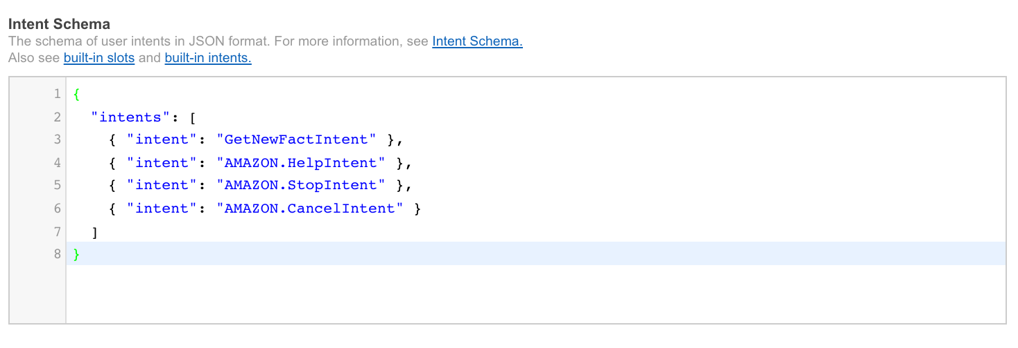
Paste the JSON into the Intent Schema Box
Instructions
Copy the code you found in SpeechAssets/IntentSchema.json into the box on the Alexa Developer dashboard.

Slide 61
Customize your Utterances
Instructions
Open up SpeechAssets/SampleUtterances.txt and replace “Major League Hacking” with your name:
01 GetNewFactIntent a fact
02 GetNewFactIntent a Major League Hacking fact
03 GetNewFactIntent tell me a fact
04 GetNewFactIntent tell me a Major League Hacking fact
05 GetNewFactIntent give me a fact
06 GetNewFactIntent give me a Major League Hacking fact
07 GetNewFactIntent tell me trivia
08 GetNewFactIntent tell me a Major League Hacking trivia
09 GetNewFactIntent give me trivia
10 GetNewFactIntent give me a Major League Hacking trivia
11 GetNewFactIntent give me some information
12 GetNewFactIntent give me some Major League Hacking information
13 GetNewFactIntent tell me something
14 GetNewFactIntent give me something
Notes:
The next thing we need to configure is the set of Sample Utterances.
This is not meant to be an exhaustive list, but should be a set of basic examples of how you want users to interact with your skill.
You can find these inside the SpeechAssets folder of the zip file you downloaded earlier.
Open the SampleUtterances.txt file and replace the relevant bits with their Invocation Name - this part is extra important

Slide 62
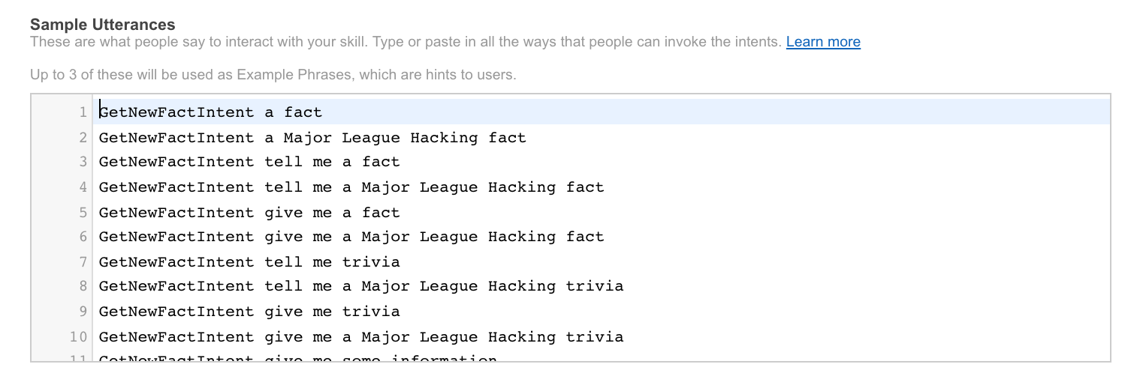
Paste your Custom Utterances into the Sample Utterances Box
Instructions
Copy your customized SpeechAssets/SampleUtterances.txt into the box on the Alexa Developer dashboard.

Slide 63
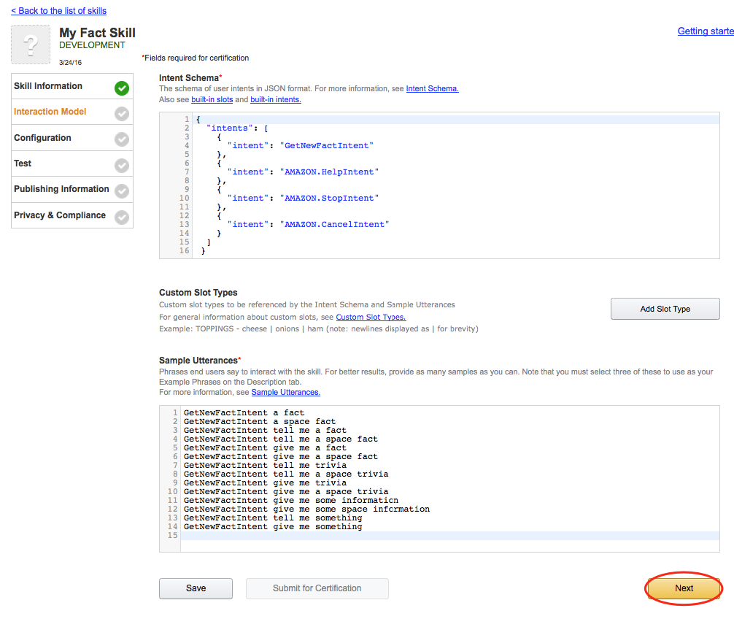
Save your Interaction Model and Continue.
Instructions
Once you’ve defined your intent schema & sample utterances,
hit “next” in the bottom corner to move on.
Notes:
Make sure that you have the correct sections filled out. They should be “Intent Schema” and “Sample Utterances”. Everything else is optional.

Slide 64
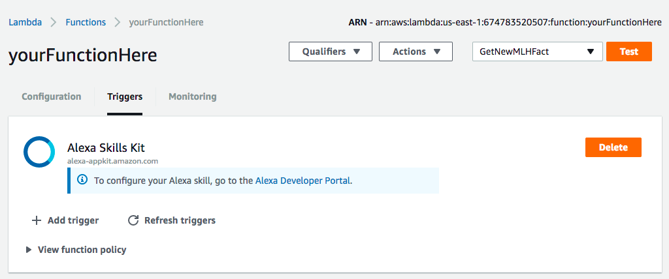
Go get your Lambda Function’s ARN
Instructions
Remember the ARN we noted down earlier?
Time to put it to use, go grab it now!

Slide 65
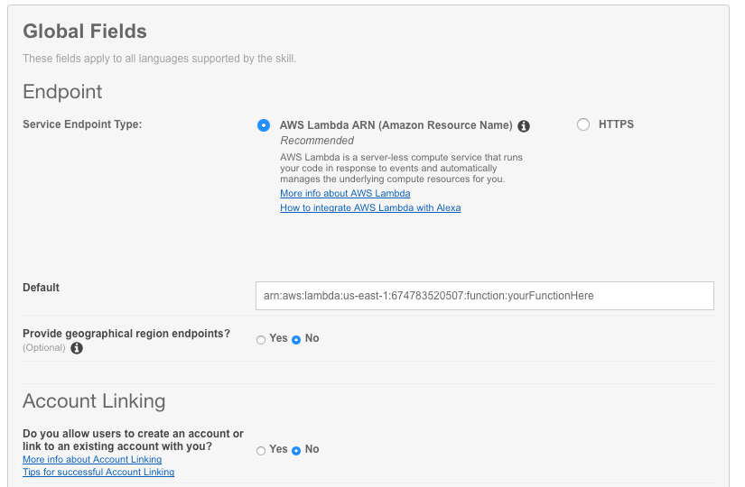
Connect Your Lambda Function to Your Skill.
Instructions
Select AWS Lambda ARN and the Region closest to you. Paste the ARN from your function in the text box.

Slide 66
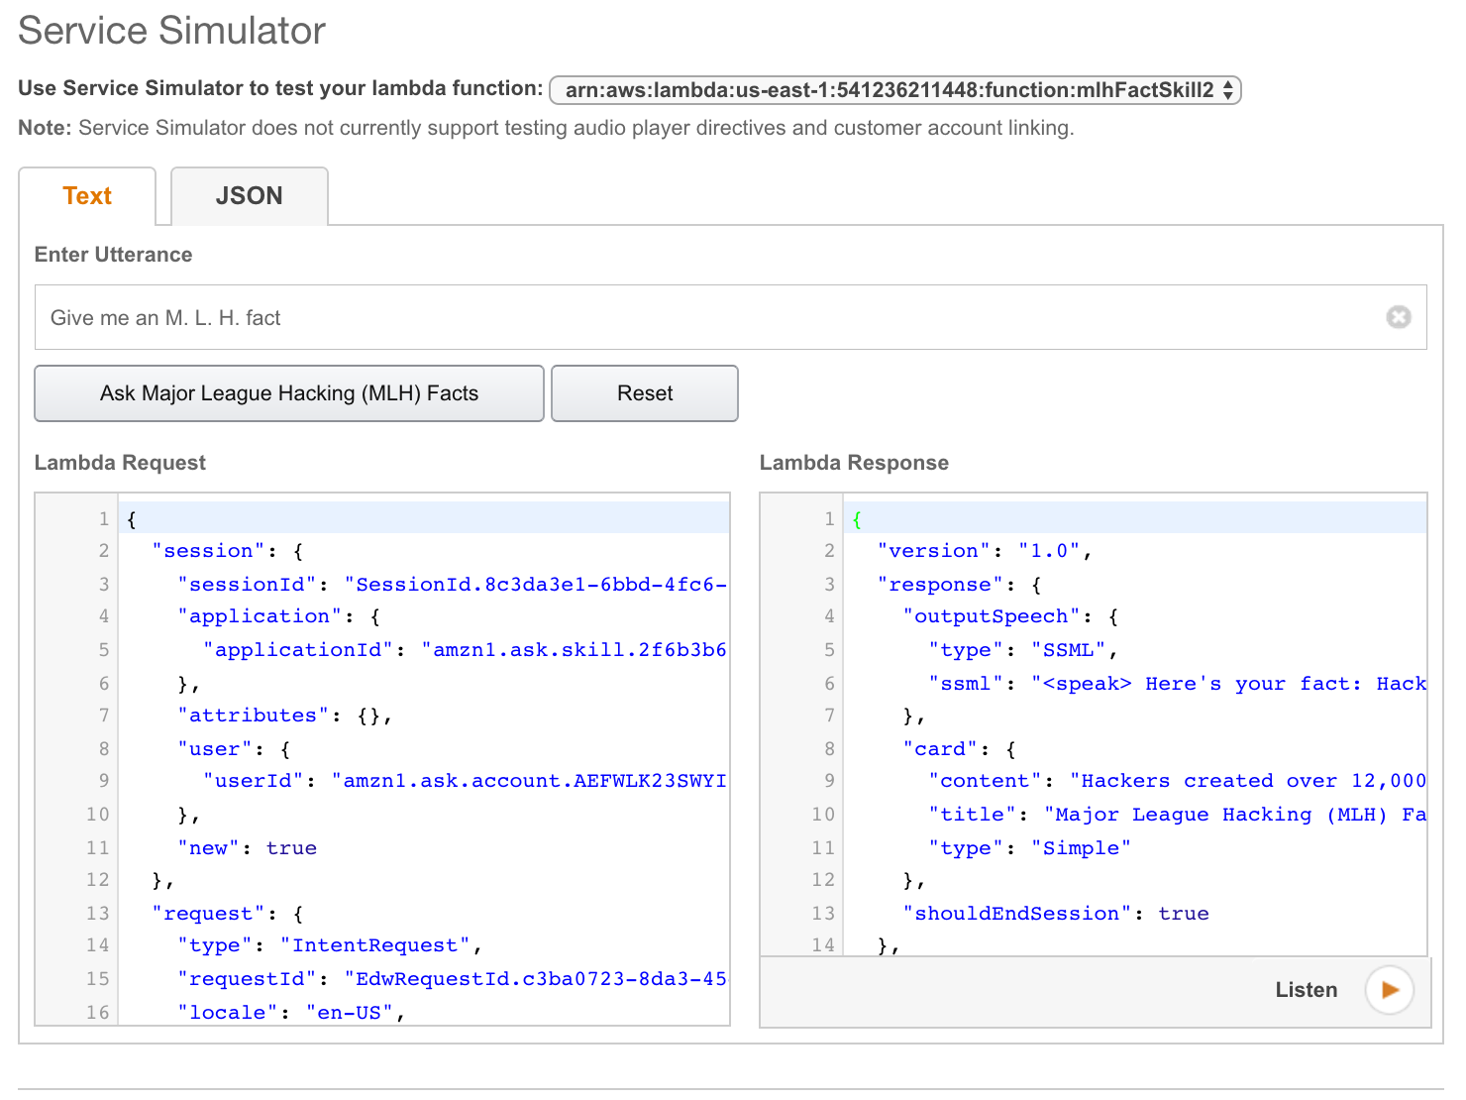
Test your Skill
Instructions
Type one of your sample utterances into the service
simulator to see how Alexa would respond.
Hear what Alexa would say by clicking “Listen”.
Notes:
If you entered all of the information correctly, you should be able to test you skill on the next page.
You can type what you would expect the user to say into the textbox under the “Service Simulator” section.
Try entering something like “Alexa open [YOUR INVOCATION NAME]” to see if you get a response.

Slide 67
Try out Your Skill!
Head to EchoSim.io to try out your fact.
“Alexa, open [Your Invocation Name].”
If you want to try your skill on an Alexa Device, pair it with your account first!

Slide 68
Troubleshooting Your Skill
If you aren't getting a valid response, check the following:
Do you have the right ARN copied from your Developer Portal/Skill into your your Lambda function?
Are you calling the right invocation name?
Are you saying launch, start or open?
Are you sure you have no other skills in your accounts with the same invocation name?

Slide 70

Let’s recap quickly...
1
Voice User Interfaces allow us to physically separate ourselves from devices.
2
Amazon Alexa makes it easy for you to create apps (skills) that utilize Voice User Interfaces.
3
Alexa takes care of speech recognition and context so you can focus on making a great app.

Slide 71
What did you learn today?
We created a fun quiz to test your knowledge and see what you learned from this workshop.
http://mlhlocal.host/quiz

Slide 73

Get credit & freebies from Amazon!
http://mlhlocal.host/alexa-promo
Our friends at Amazon Web Services run promotions in certain areas to reward hackers for making skills for the Amazon Alexa Platform.
Fill this out to get credit!

Slide 74
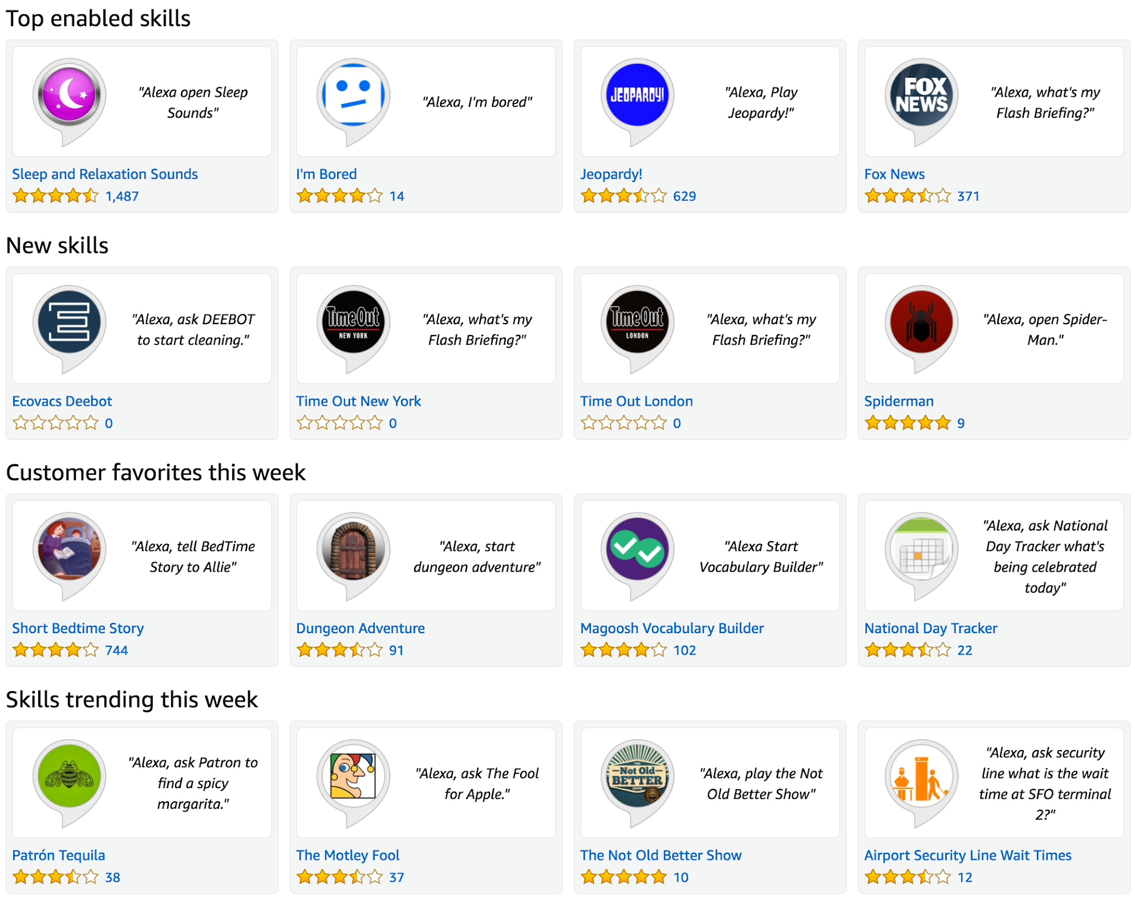
Next Steps: Publish your Skill!
You have a working skill, the next step is to publish it on the Alexa Skill Marketplace.
Instructions
Complete the “Publishing Information” and “Privacy and Compliance” sections on the developer portal.
Ensure that your skill meets the basic requirements.

Slide 75

Next Steps: Use Slots to Customize Further
Slots enable you to pass additional data to your Lambda function. Use slots to return a fact in a specific category (Ex. “facts about my education”).
Instructions
Read up about Slots and how to use them to pass data to your function.
Categorize your facts into a handful of groups.
Customize your function to return a fact based on the user specified category

Slide 76

Learning shouldn’t stop when the workshop ends...
Check your email for access to:
These workshop slides
Practice problems to keep learning
Deeper dives into key topics
Instructions to join the community
More opportunities from MLH!

Slide 77
v.0.0.1

